Slide 1

Introduction to Virtualization
Hwanju Kim

Slide 2
Outline
Goals
Understanding the benefits of virtualization in IT industry and how to virtualize HW resources
Schedule
Introduction to virtualization
OS vs. VMM
CPU virtualization and scheduling
Memory virtualization and management
I/O virtualization
Live VM migration
Introduction to Systemtap

Slide 3
How to Learn Virtualization?
Conference proceedings
SOSP
Symposium on Operating Systems Principles
OSDI
Symposium on Operating Systems Design and Implementation
ASPLOS
International Conference on Architectural Support for Programming Languages and Operating Systems
USENIX ATC
USENIX Annual Technical Conference
EUROSYS
European Conference on Computer Systems
VEE
International Conference on Virtual Execution Environments
SOCC
ACM Symposium on Cloud Computing
Open source software
Xen, KVM, VirtualBox

Slide 4
What is Virtualization?
Multiple OSes on a single machine
Giving an illusion that each OS is running on real HW
Virtual Machine Monitor (VMM)
Another layer of kernel to virtualize multiple OSes
Also called “hypervisor”
An OS as a supervisor is no more HW-dictator!
App
App
App
App
App
App
App
App
Windows
Linux
Mac
Virtual Machine Monitor
Hardware

Slide 5


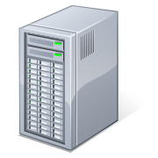



History – Born and Died (1/4)
1960s-1970s
High cost of computing machines
IBM VM/370: A VMM for IBM mainframe
1980s-1990s
But, lost attentions since PC era (1980s)
Cheap HW → No need to share hardware
CPU did not support virtualization well
High engineering cost and overhead
Powerful &
expensive
hardware

Slide 6
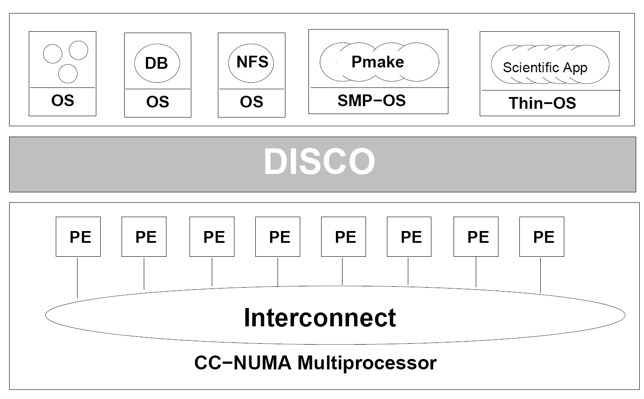
History - Reborn (2/4)
The late 1990s
Regain attention for “server consolidation”
Toward cost-effective large-scale computing
Stanford’s research project: Disco
They founded VMware in 1998
Disco: Running Commodity Operating Systems on Scalable Multiprocessors [SOSP’97]

Slide 7
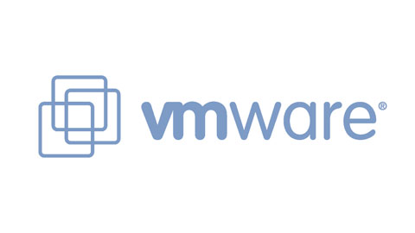

History - Renaissance (3/4)
1998-2002
VMware
“Full-virtualization”
Running unmodified OS
Starting with SW-based binary translation
Success in industry and academia
VMware‘s state-of-the-art techniques in SOSP and OSDI
2003
Xen
University of Cambridge’s project: Open source!!!
“Xen and Art of Virtualization” [SOSP’03]
“Para-virtualization”
Modified OS for near-native performance: Linux on x86
2003-
Virtualization research renaissance based on Xen
2007: Acquired by Citrix

Slide 8
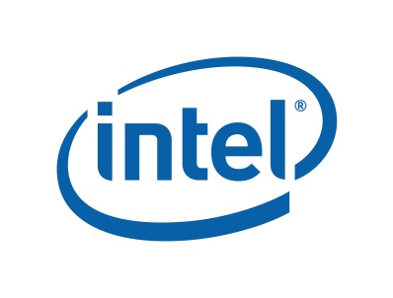

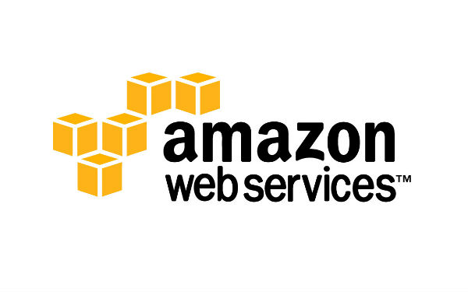
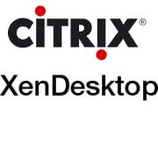



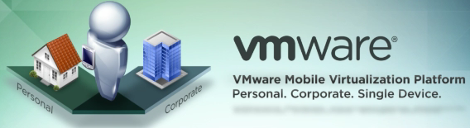
History - Ubiquitous (4/4)
2005-2006
HW-assisted virtualization
x86 virtualization
Intel VT-x & AMD-V
Running unmodified OS with near-native performance
Default functionality now
2006-now
Cloud computing
Infrastructure-as-a-Service (IaaS)
Virtual desktop infrastructure (VDI)
Mobile virtualization
ARM virtualization technology (Cortex-A15)

Slide 9
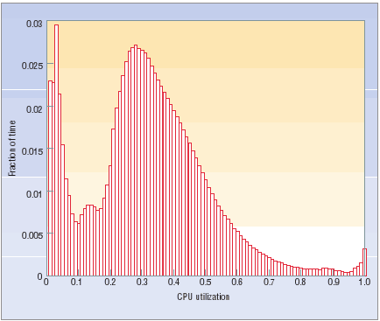
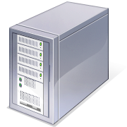
Why Virtualization? (1/6)
Efficient resource utilization
Low resource utilization of each server machine
Low total cost of ownership (TCO)
Low cost of infrastructure and energy
Average CPU utilization of 5000+ Google’s servers
Mostly 0-50% utilization
VM
VM
VMM
CPU
CPU
CPU
VM
CPU
The Case for Energy-Proportional Computing [IEEE Computer’07]

Slide 10
Why Virtualization? (2/6)
Flexible VM relocation
“Live VM migration”
Flexible VM relocation with near-zero downtime
Flexible load balancing
Relieving resource bottleneck
VM
VM
VM
CPU
CPU
CPU
CPU

Slide 11
Why Virtualization? (3/6)
Flexible VM relocation
“Live VM migration”
Flexible VM relocation with near-zero downtime
High availability
VM
SW or HW maintenance
(upgrade or fix)

Slide 12
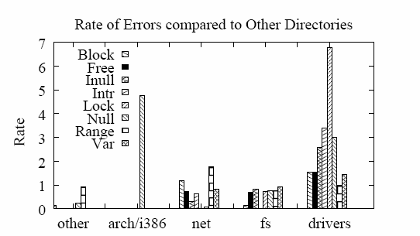
Why Virtualization? (4/6)
Strong isolation
Strong isolation between co-located VMs
Fault containment or isolation
Safe from bugs and malicious attacks
Safe
OSes, especially drivers, are error-prone
App
App
VM
VM
OS
OS
OS
VMM
Hardware
Hardware
VMM is much smaller than OS
→ Low trusted computing base (TCB)
An empirical study of operating systems errors [SOSP’01]

Slide 13

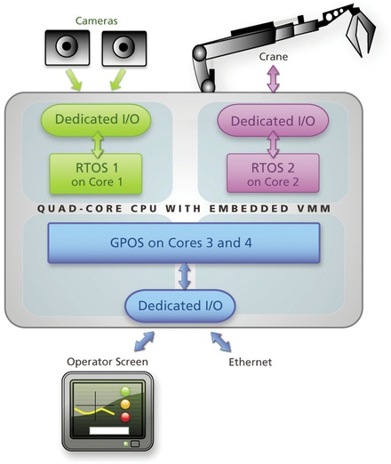
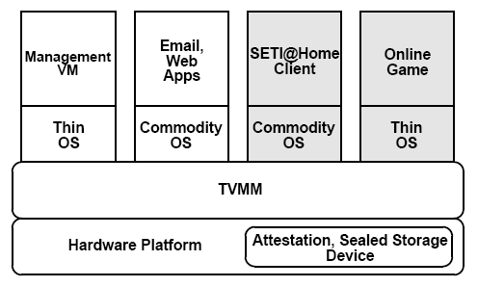
Why Virtualization? (5/6)
Multiple OSes on a single device
OS dependency of legacy SW
Linux + Windows, Android + iOS
Different requirements of SW
Virtualization for embedded or mobile systems
RTOS + GPOS
Building secure systems
Security-enhanced OS + GPOS
Trusted VMM
Allowing for GPOS and RTOS:
The unique virtualization
needs of mission-critical
embedded systems,
TenASys
Terra: A Virtual Machine-Based Platform for Trusted Computing [SOSP’03]

Slide 14
Why Virtualization? (6/6)
Other benefits
Strong security monitoring
Security monitoring outside OSes
Ease of deployment
Virtual appliance
A bundle of OS and applications
Flexible testing and debugging
Building distributed environments on a single machine
Kernel development and debugging
VM-based recording and replaying

Slide 15
Use Cases
Cloud computing
Virtual desktop infrastructure
Mobile virtualization

Slide 16
Virtualization & Cloud Computing
Virtualized data centers
Virtualization 1.x: Near term
Virtualization 2.0: Emerging
Virtualization 3.0: Future
2013+
Virtualization 3.0
The fully virtualized datacenter
for cloud services
Virtualization 2.0
2009
Virtualization 1.x
출처: IDC 2010 report

Slide 17
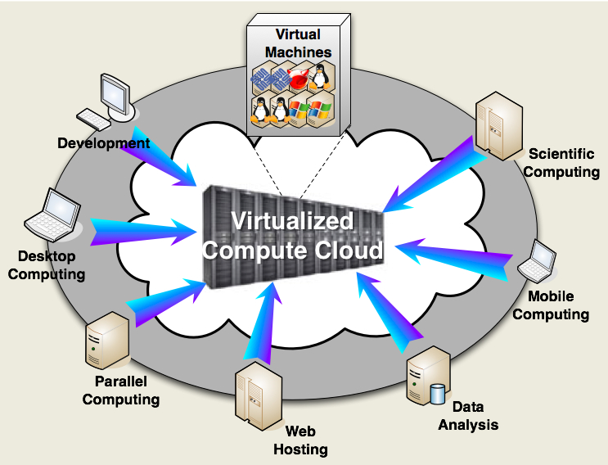
Virtualization & Cloud Computing
VM-based resource pool for various demands
Infrastructure-as-a-Service (IaaS)

Slide 18







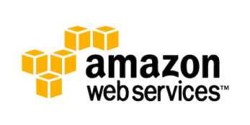
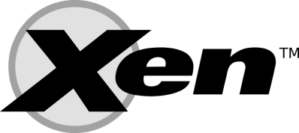






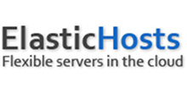

Virtualization & Cloud Computing
Many providers use commercial & open-source VMMs
Virtualization Solutions | Cloud Providers

Slide 19
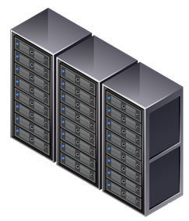
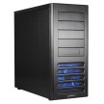
Virtual Desktop Infrastructure (VDI)
Desktop provisioning
Dedicated workstations
VM-based shared environments
VM
VM
VM
VM
VM
Energy wastage by idle desktops
Resource underutilization
High management cost
High maintenance cost
Low level of security
+ Energy savings by consolidation
+ High resource utilization
+ Low management cost
(flexible HW/SW provisioning)
+ Low maintenance cost
(dynamic HW/SW upgrade)
+ High level of security
(centralized data containment)

Slide 20
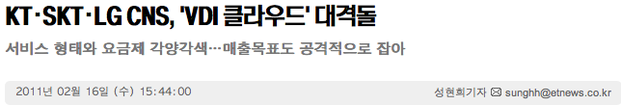






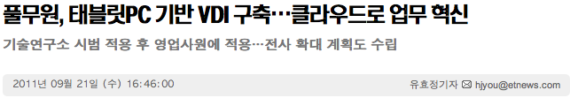
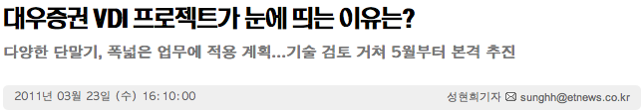
Virtual Desktop Infrastructure (VDI)
VDI is also hot in Korea

Slide 21
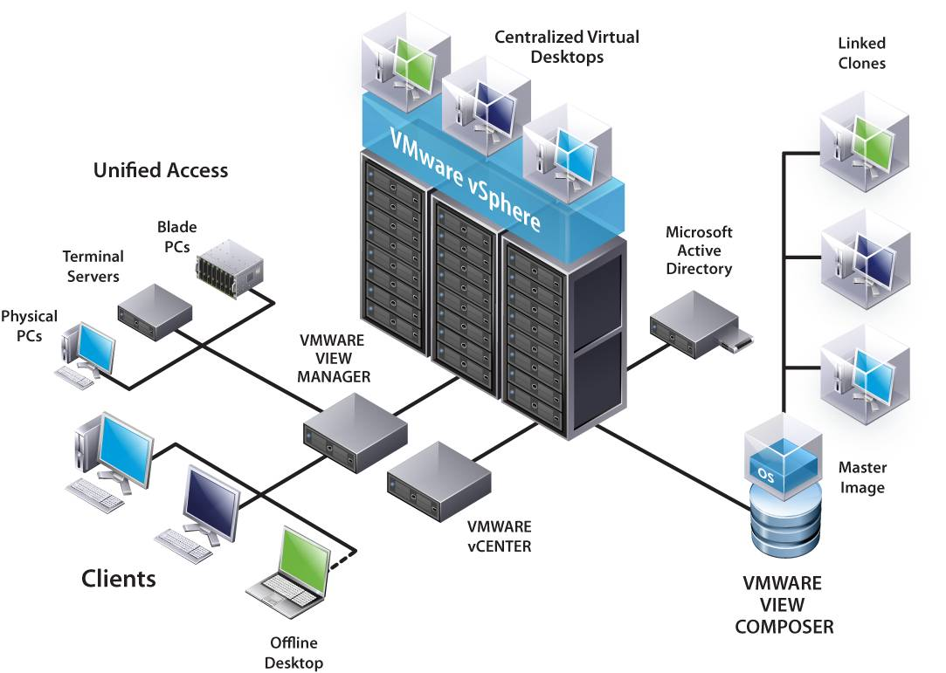
Virtual Desktop Infrastructure (VDI)
VMware VDI
Pioneer of VDI

Slide 22
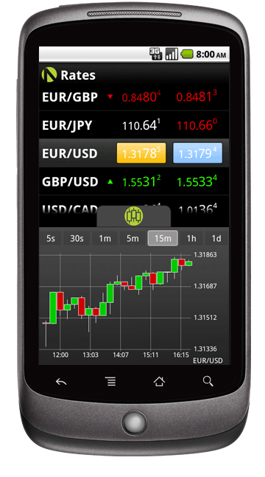
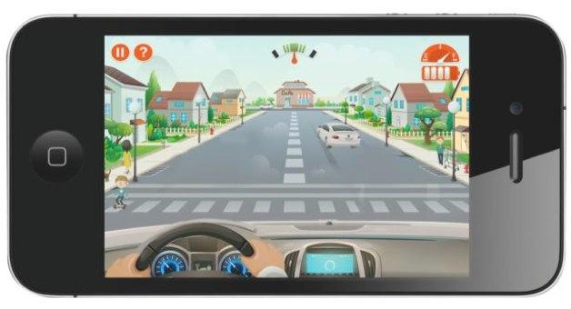
Mobile Virtualization
Trends of consumer electronics
Digital convergence
What do consumer electronics(CE) devices want to achieve?
Reliability
Trustworthiness for primary functions
Extensibility
Flexibility for adding features as needed
Business
Phone
Personal
Phone

Slide 23




Mobile Virtualization
BYOD: Bring Your Own Device
Consolidating business and personal
computing environments on a single device
Managed
domain
Business
VM
Personal
VM
Hypervisor

Slide 24
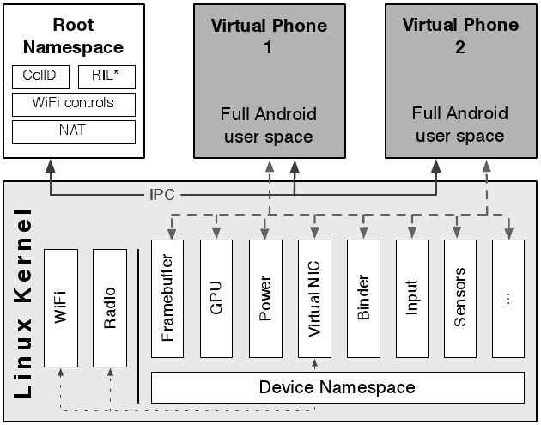
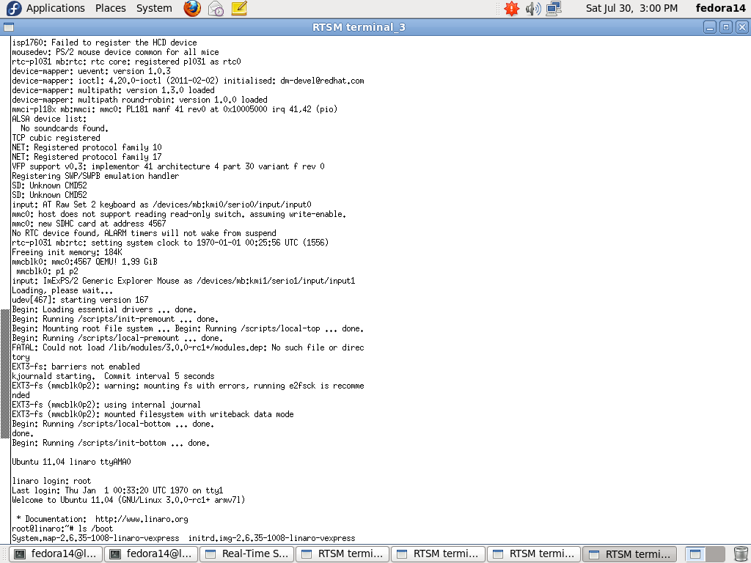
Mobile Virtualization
Academia
Columbia university’s projects
Cells [SOSP’11]
KVM for ARM [OLS’10]
Cortex-A8, A9
Now running on A15
Linaro Ubuntu 11.04 for ARM
running in VM by KVM/ARM
(Cortex-A15 in Fast Model 6.1)
Cells: A Virtual Mobile Smartphone Architecture [SOSP’11]
OS-level virtualization

Slide 25
Mobile Virtualization
Embracing all apps in a unified market
iOS + Android + Windows
Technically possible, but not yet by industry
Currently, not much attractive.
Multiple Androids
Android + RTOS
Issues
Performance, performance, performance…
Graphics acceleration → Challenging
CPU, memory limitation
High-end smartphones can resolve this limitation

Slide 26
Basic Terminologies
Types of VMMs
Type-1 vs. Type-2
Virtualization methods
Full-virtualization vs. Para-virtualization

Slide 27
Type-1 vs. Type-2
Depending on what sits right on HW
Type-1: VMM on HW
Type-2: Host OS on HW
Guest VM
Guest VM
Host OS
Guest VM
Guest VM
Guest OS
Guest OS
Guest OS
Guest OS
VMM
VMM
HW
HW
Xen, VMware ESX server, Hyper-V
Mostly for server, but not limited
VMM by default
OS-independent VMM
KVM, VMware Workstation, VirtualBox
Mostly for client devices, but not limited
VMM on demand
OS-dependent VMM

Slide 28
Xen: Type-1 VMM
Type-1 VMM
Para-virtualization and full-virtualization
Domain0
Privileged VM for guest VM (domainU) management
Handling I/O operations requested from domainUs
Including native device drivers to directly access HW
Domain0
(Privileged VM)
DomainU
(Guest VM)
DomainU
Guest VM
Linux
Guest OS
Guest OS
Xen VMM

Slide 29


KVM: Type-2 VMM
Type-2 VMM for Linux as a host OS
Based on HW-assisted virtualization
Linux kernel mainline (2.6.20~)
Linux Process
QEMU
Guest VM
Host OS
(Linux)
Linux Thread
I/O emulation
Guest OS
Linux Thread
Linux Thread
vCPU
vCPU
User space
Kernel space
KVM VMM (kernel module)

Slide 30
Full- vs. Para-virtualization
Depending on whether OS source is modified
Full-virtualization = No OS source modification
SW-based full virtualization
Emulation
HW-based full virtualization
HW-assisted virtualization
Para-virtualization = OS source modification
Virtualization-aware OS
Bridging semantic gap between VMM and OS
Mostly for performance
Today’s virtualization solutions adopt both approaches for optimized performance

